Slide 1
Optimism for nuclear power around the globe
Josh Inwald
December 2, 2021
Psyc 575 MLM Final Project

Slide 2
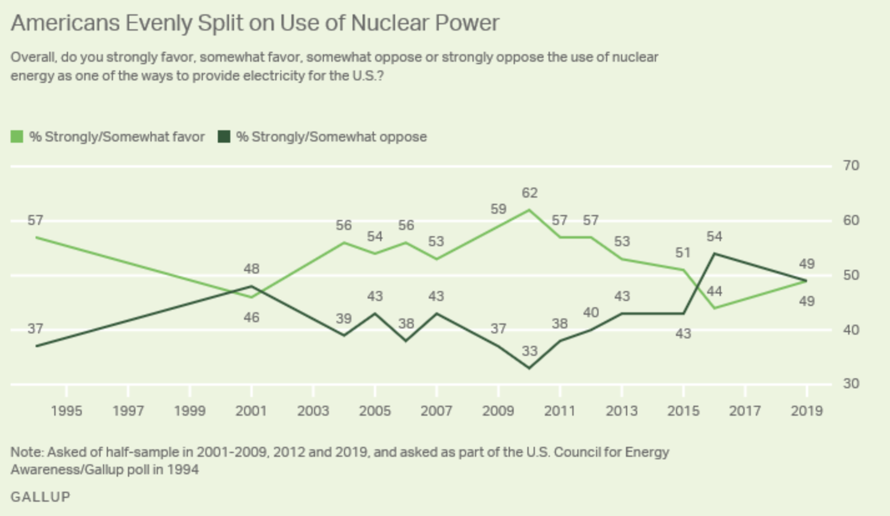
Support for nuclear power is stable over time, and relatively low compared to other energy sources
The public’s opinion of nuclear power tends to change slowly over time, except for major events¹
Three Mile Island (1979), Chernobyl (1986), Fukushima Daiichi (2011)
Nuclear has lower public support than most renewable sources
2007 Eurobarometer poll²: 20% in-favor of nuclear, 25% support for oil / coal, 70+% support for solar / wind

Slide 3
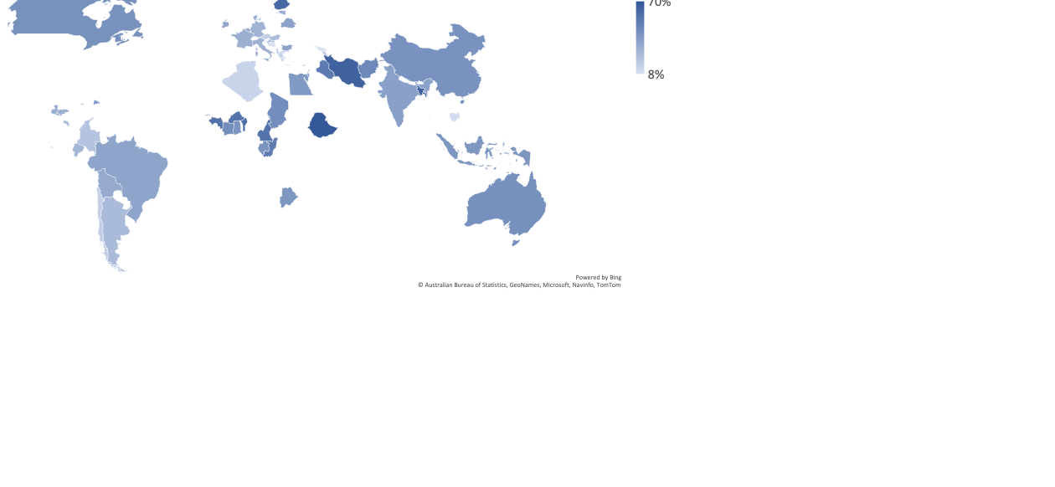
Optimism for nuclear power varies greatly– global average = 40% optimistic (vs not)
Historically, countries with nuclear power are more accepting¹
Niger
Montenegro

Slide 4
Demographics, climate change and trust-in-government influence support for nuclear power
Individual differences that predict support for nuclear power¹
Older age
College education
Male gender
Middle-right political ideology (American / Western European context)
Support for nuclear power increases after explaining the climate benefits of nuclear reactors²
When it comes to information about nuclear power, people trust, in order, 1) scientists, 2) media, 3) government^{3,4}

Slide 5
My goal is to replicate prior findings on a global scale, then improve fit using novel constructs
Research on public opinions of nuclear power has almost exclusively been conducted in North America, Europe and Japan
Validate: Do proven demographic predictors of feelings towards nuclear energy generalize to a global sample?
Novel RQ: Does risk perception of climate change predict nuclear optimism?
Novel RQ: Does trust in government predict nuclear optimism?
Bonus: Compare models (plus “kitchen-sink” approach) using AIC to determine the best model of nuclear optimism around the world

Slide 6
Dataset: Lloyd’s Register Foundation funded a 142-country survey of risk perception around the globe
Administered by Gallup in 2018-2019
Random address-based sample in 142 countries (n > 150,000)
Nuclear optimism survey question (DV): Please tell me whether you think the use of nuclear power for electricity will mostly HELP or mostly HARM people in this country in the next 20 years
NOTE: All models will be run using DV coded as -1 (harm), 0 (neutral), or 1 (help)
NOTE: Non-responses (don’t know, refused to answer) coded as 0
NOTE: Gallup provides survey weights, however I’m more interested in individual differences than cross-country comparisons (plus including weights interferes with some useful functions), so I will not utilize them
Notes:
Gallop = global experts in polling. They have direct presence in all 142 countries, and has decades of experiences conducting similar research on threat perception
Emphasize importance of being able to conduct the research in Global South

Slide 7
1) Develop a base MLM using controls (variables of construal interest in next phase)
Treat participants (Level 1) as nested within countries (Level 2)
Start with base model predicting nuclear optimism using age, gender and education (informed by literature review; centering doesn’t seem appropriate here), plus random intercepts for countries
Get ICC
Test whether including additional controls (income, country level of economic development, whether country has active civilian nuclear power plants) improves model fit

Slide 8
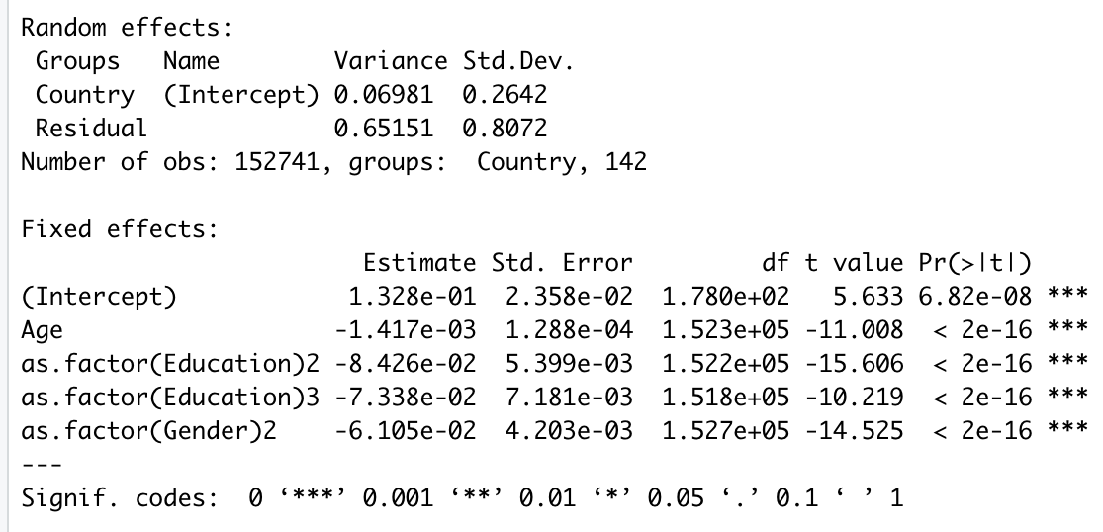
The basic model illustrates the challenges of working with this dataset and DV
ICC: 0.09 (low ICC)
All fixed effects significant due to massive sample size
Sign of age / education betas do not match my intuition
Scale of DV {-1, 0, 1} also makes interpretation somewhat odd

Slide 9
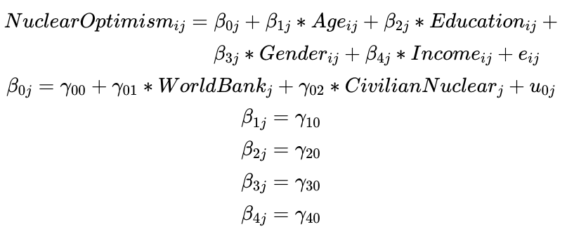
AIC of slightly more complex models recommends including additional controls
Best conditional R² = 0.11
Base model equation:
Model IVs | AIC
Age, education, gender | 368703.5
Age, education, gender, income quintile | 366017.4
Age, education, gender, World Bank country income classification (L2)¹ | 368678.7
Age, education, gender, income quintile, nuclear power (L2) | 368703.8
Age, education, gender, income quintile, World Bank country income classification (L2)¹, civilian nuclear power (L2) | 365983.1

Slide 10
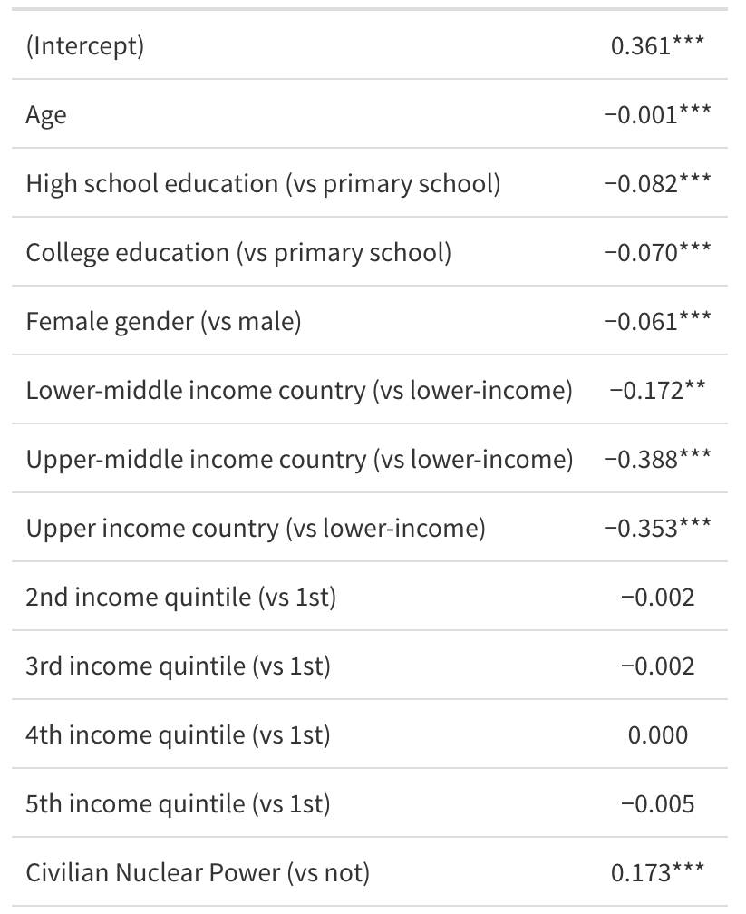
Global view: Some fixed effects contradict my literature-based intuition, others align with predictions
Age: Effect is almost zero
Education: More education predicts less nuclear optimism (contradicts literature)
Gender: Female gender predicts less nuclear optimism (aligned with literature)
World Bank country income: Wealthier countries are less optimistic about nuclear
Income quintile: No significant effects
Civilian nuclear power: Having nuclear power predicts more nuclear optimistic

Slide 11
2) Building off base model, add climate change concern as a predictor of nuclear optimism
Decompose IV into country-means + country-mean-centered
CM prediction: Countries with high concern for climate change will be more afraid of nuclear power (based off Green politics in many wealthy nations)
CMC prediction: No significant effect in either direction (people concerned with climate change might identify nuclear power as a climate solution, but they also might think nuclear is too environmentally dangerous)
LRT to justify inclusion of random slopes for climate change variable
Climate change survey question (IV): Do you think that climate change is a very serious threat, a somewhat serious threat, or not a threat at all to the people in this country in the next 20 years?

Slide 12
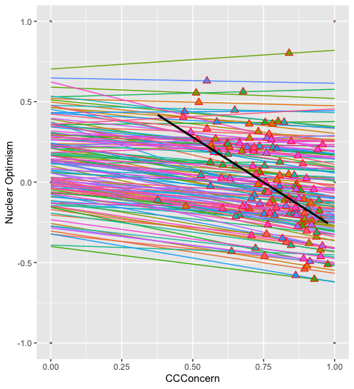
Interpreting output from climate change concern model (1 of 2)
Intercept: For people in a country with mean climate concern = 0 and all predictors = 0, predicted nuclear optimism is 0.80 (SE = 0.11)
Climate change concern country-means: Countries with greater average climate concern are predicted to express lower optimism for nuclear power
At the country level, a 1-unit increase in country mean climate change concern (i.e. comparing a fully unconcerned to a fully concerned country) is associated with a -0.72 (SE = 0.15) unit decrease in average nuclear optimism of that country

Slide 13
Interpreting output from climate change concern model (2 of 2)
Climate concern (CMC’d): Individuals concerned about climate change are predicted to be less optimistic about nuclear power
Technically: On average, within a country, a 1-unit increase in climate concern (i.e., being concerned about climate change vs unconcerned) is associated with a -0.18 (SE = 0.13) unit decrease in nuclear optimism (range: -1 to 1)
Random effects: For most countries, concern for climate change and optimism about nuclear power are negatively associated, with ~68% of regression coefficients between -0.31 and -0.05 (average slope ± τ₁)
Note: LRT supports the inclusion of random slopes, p < 0.000001 in one-tailed χ² (df = 2) test comparing deviances of models with/without random slopes

Slide 14
Modeling progress report
Variable | Base Model Estimate | Climate Change Model Estimate
(Intercept) | 0.361*** | 0.798***
Age | -0.001*** | -0.001***
High school education (vs primary) | -0.082*** | -0.064***
College education (vs primary) | -0.070*** | -0.043***
Female gender (vs male) | -0.061*** | -0.063***
Lower-middle income country (vs lowest) | -0.172** | -0.134*
Upper-middle income country (vs lowest) | -0.388*** | -0.270***
Upper-income country (vs lowest) | -0.353*** | -0.184***
2nd Income quintile (vs poorest) | -0.002 | 0.002
3rd Income quintile (vs poorest) | -0.002 | 0.004
4th Income quintile (vs poorest) | -0.002 | 0.007
5th Income quintile (vs poorest) | -0.005 | 0.003
Civilian nuclear power (vs not) | 0.173*** | 0.155***
Fixed effects (compared to base / controls-only model):
World Bank income categories are less predictive (betas closer to 0) and have larger (but still significant) p-values – sensible because climate change concern has high correlation with country income
Otherwise, fixed effect betas are in the same ballpark in terms of magnitude and significance
Climate concern conditional R² = 0.11

Slide 15
3) Building off base model, add trust-in-government as a predictor of nuclear optimism
Decompose IV into country-means + country-mean-centered
CM prediction: Countries with high trust in government safety efficacy will be more optimistic about nuclear power (trust government to adequately mitigate risk)
CMC prediction: Same direction of effect for individuals
LRT to justify inclusion of random slopes for trust-in-government variable
(I investigated the cross-level interaction between trust-in-government and whether a country has civilian nuclear energy, but the results were extremely non-significant – shame ☹)

Slide 16
I created a scale of people’s trust in their government to effectively ensure public safety
Original survey question (x3): In general, does the government do a good job ensuring that the following are safe, or not? (1) The food you buy; (2) The water you drink; (3) Powerlines in the area you live in
Model IV is the sum of scores to these three binary questions; on the surface, it appears to be a valid scale
Cronbach’s α = 0.77, ω-total = 0.78
New GovSafeEff variable: range = [0 , 3]; mean = 1.84; SD = 1.21; median = 2

Slide 17
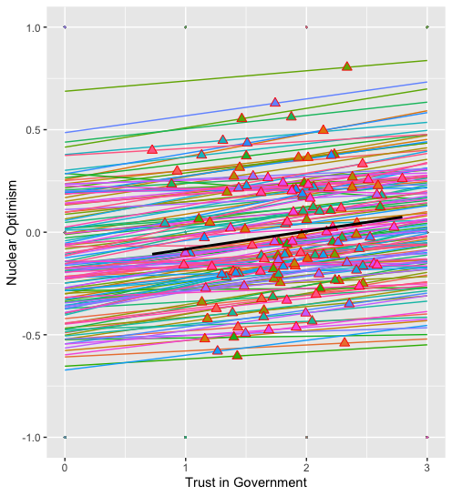
Interpreting output from trust-in-government-safety model (1 of 2)
Intercept: For people in a country with mean trust-in-government = 0 and all predictors = 0, predicted nuclear optimism is 0.15 (SE = 0.09)
Trust-in-government country-means: Countries with higher average trust-in-government are predicted to express greater optimism for nuclear power
Technically: At the country level, a 1-unit increase in trust-in-government score is associated with a 0.12 (SE = 0.04) unit increase in average nuclear optimism of that country

Slide 18
Interpreting output from trust-in-government-safety model (2 of 2)
Trust-in-government (CMC’d): Individuals who trust in their government are predicted to be more optimistic about nuclear power
Technically: On average, within a country, a 1-unit increase in trust-in-government is associated with a 0.06 (SE = 0.004) unit increase in nuclear optimism (range: -1 to 1)
Random effects: For most countries, trust-in-government and optimism about nuclear power are positively associated, with ~68% of regression coefficients between 0.02 and 0.10 (average slope ± τ₁)
Note: LRT supports the inclusion of random slopes, p < 0.000001 in one-tailed χ² (df = 2) test comparing deviances of models with/without random slopes

Slide 19
Progress report
Variable | Base Model Estimate | Climate Change Model Estimate | Trust-in-Gov Model Estimate
(Intercept) | 0.361*** | 0.798*** | 0.149***
Age | -0.001*** | -0.001*** | -0.001***
High school education (vs primary) | -0.082*** | -0.064*** | -0.075***
College education (vs primary) | -0.070*** | -0.043*** | -0.061***
Female gender (vs male) | -0.061*** | -0.063*** | -0.058***
Lower-middle income country (vs lowest) | -0.172** | -0.134* | -0.165**
Upper-middle income country (vs lowest) | -0.388*** | -0.270*** | -0.381***
Upper-income country (vs lowest) | -0.353*** | -0.184*** | -0.416***
2nd Income quintile (vs poorest) | -0.002 | 0.002 | -0.004
3rd Income quintile (vs poorest) | -0.002 | 0.004 | -0.005
4th Income quintile (vs poorest) | -0.002 | 0.007 | -0.001
5th Income quintile (vs poorest) | -0.005 | 0.003 | -0.005
Civilian nuclear power (vs not) | 0.173*** | 0.155*** | 0.177***
Fixed effects betas are still in the same ballpark in terms of direction, magnitude and significance
Trust-in-government safety conditional R² = 0.12

Slide 20
4) Let’s compare the three theory-informed models, plus kitchen-sink and combination models
NOTE: Changing sample sizes (due to some N/As throughout dataset) means that AIC-comparisons are a bit misguided
Model | AIC | Conditional R² | n
Base controls: Age, education, gender, income quintile, World Bank country income classification, civilian nuclear power) | 365983 | 0.11 | 151663
Climate chance concern: Base + decomposed climate change concern, random slopes on concern-CMC) | 364666 | 0.11 | 151663
Trust-in-government: Base + decomposed trust in government safety efficacy, random slopes on trust-CMC) | 359945 | 0.12 | 149576
Climate change concern + Trust-in-government + base controls (random slopes for both climate change and trust) | 358725 | 0.12 | 149576
Kitchen sink model: Base + numeracy (vs innumerate), urban (vs rural), overall safety feelings (more / less / as safe compared to five years ago), GMO optimism (same scale as DV), AI optimism (same scale as DV), belief that governments should ensure workplace safety (vs not), social media usage (vs not) | 344541 | 0.18 | 148547
Combo + kitchen sink suggestions (any significant fixed effects with β > 0.1) | 346069 | 0.18 | 149576

Slide 21
Final model outputs
Variable | Estimate
(Intercept) | 0.441***
Climate change concern (vs unconcerned) – country-means | -0.445***
Climate change concern (vs unconcerned) – country-mean-centered | -0.113***
Trust-in-government – country-means | 0.046
Trust-in-government – country-mean-centered | 0.038***
GMO optimism | 0.197**
AI optimism | 0.185***
Variable | Estimate
Civilian Nuclear Power | 0.136***
Age | -0.000***
High school education (vs primary school) | -0.017**
College education (vs primary school) | -0.013
Female gender (vs male) | -0.034***
Lower-middle income country (vs lower-income) | -0.073
Upper-middle income country (vs lower-income) | -0.174***
Upper income country (vs lower-income) | -0.169**
Variable | Estimate
2nd income quintile (vs 1st) | 0.441***
3rd income quintile (vs 1st) | -0.445***
4th income quintile (vs 1st) | -0.113***
5th income quintile (vs 1st) | 0.046
Number of observations | 149576
R² Marginal | 0.14
R² Conditional | 0.18
AIC | 346069
ICC | 0.1
RMSE | 0.77
Italics indicate Level 2 IVs (all others Level 1) | Significance codes (p < α): [***] = 0.001; [**] = 0.01; [*] = 0.05

Slide 22
For robustness, I re-ran the final model as a binary logistic
Variable | Trinary DV Estimate | Binary DV Estimate
(Intercept) | 0.441*** | 0.426
Climate change concern (vs unconcerned) – country-means | -0.445*** | -0.940*
Climate change concern (vs unconcerned) – country-mean-centered | -0.113*** | 0.042
Trust-in-government – country-means | 0.046 | 0.153
Trust-in-government – country-mean-centered | 0.038*** | 0.148***
GMO optimism | 0.197** | 0.417***
AI optimism | 0.185*** | 0.466***
Age | -0.000** | -0.004***
Civilian Nuclear Power (vs not) | 0.136*** | 0.448***
High school education (vs primary school) | -0.017** | 0.120***
College education (vs primary school) | -0.013 | 0.241***
Female gender (vs male) | -0.034*** | -0.267***
Lower-middle income country (vs lower-income) | -0.073 | -0.388**
Upper-middle income country (vs lower-income) | -0.174*** | -0.679***
Upper income country (vs lower-income) | -0.169** | -0.641***
2nd income quintile (vs 1st) | 0.441*** | 0.033
3rd income quintile (vs 1st) | -0.445*** | 0.064**
4th income quintile (vs 1st) | -0.113*** | 0.087***
5th income quintile (vs 1st) | 0.046 | 0.094***
Number of observations | 149576 | 149576
R² Conditional | 0.18 | 0.22
DV: Belief that nuclear power will help = 1, all other responses = 0
glmer equivalent to glmmTMB
brms() would not run with defaults
Convergence + eigenvalue warnings
Turns out my model isn’t super robust with respect DV parameterization
Differences in significant betas
Reversed sign for Level 1 effects of climate change, education and income quintiles
Binary model produces larger R² (!?)

Slide 23
Running through the Mark’s model diagnostics checklist, I do not spot any obvious violations
Linearity – Not super relevant because most predictors are binary
Climate concern and trust-in-government marginal model plots check out
Independence of errors (at highest level) – No reasons to suspect errors are correlated beyond people-nested-in-countries assumptions
Normality – Quantile-quantile plot shows large deviations from normality, but that’s to be expected with a DV with response options {-1, 0, 1}
Equal variance of errors (homoscedasticity) – A handful of small states look off (e.g. Eswatini), but nothing systematic, and most residuals within ±1 SD
Correct model specification – Hopefully I made intelligent centering and variable inclusion decisions!

Slide 24
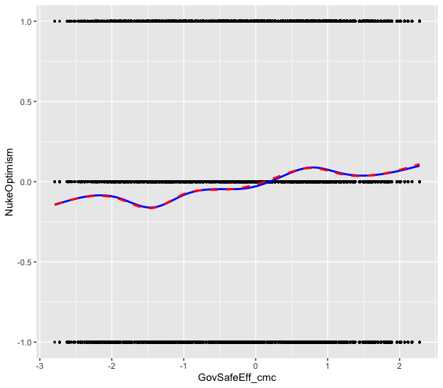
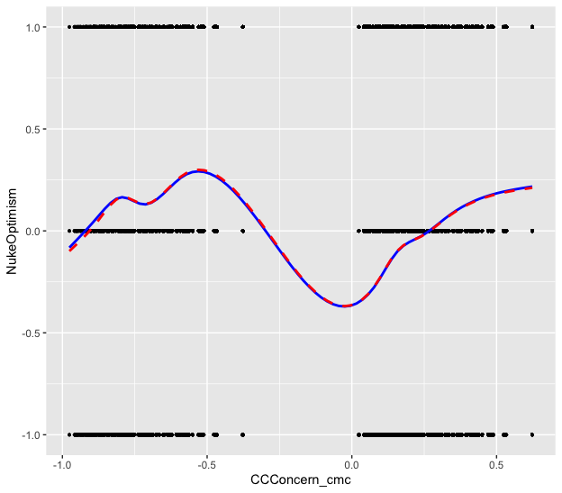
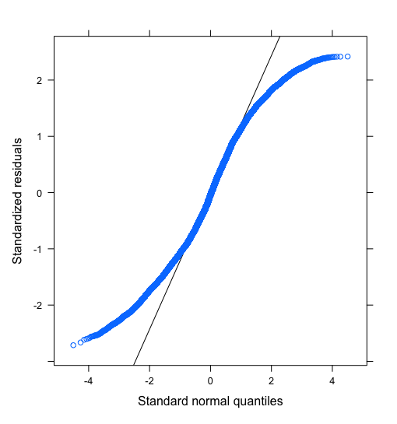
MMPs don’t show noted departures from linearity, and Q-Q plot is sensible given DV response options

Slide 25
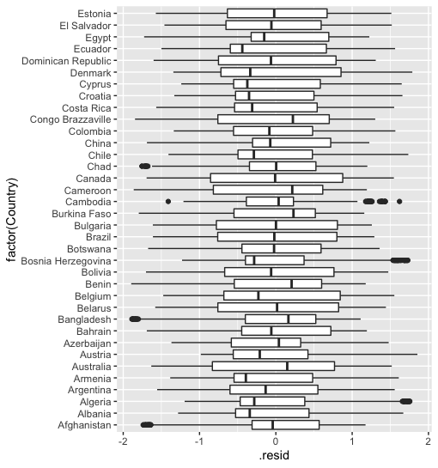
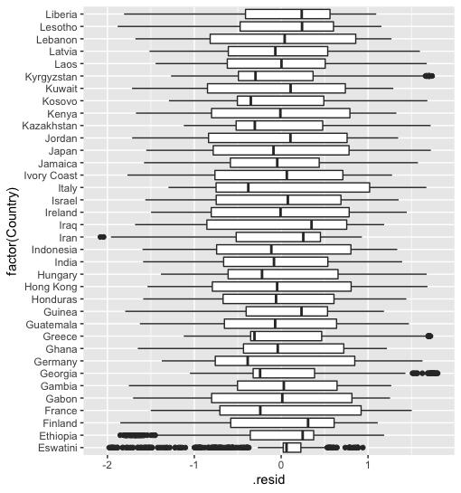
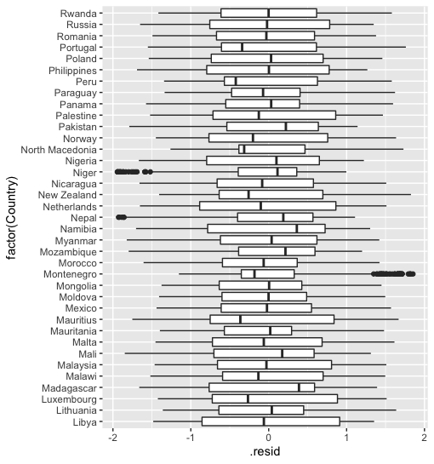
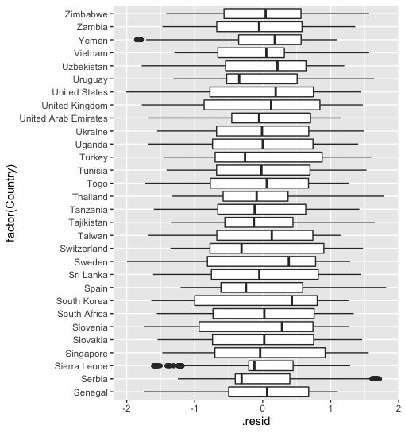
Residual boxplots: Almost all countries 25th-75th residuals are between ±1 SD

Slide 26
Most of my findings contradict expectations from existing nuclear energy public opinion research
Aside from gender and civilian nuclear power dummies, most controls worked in the opposite direction suggested by prior research
Education: Greater education predicts lower nuclear optimism
Age: Probably no effect, but if anything, slightly negative relationship
National economic development (World Bank): Rich countries are less optimistic about nuclear power than poor countries
The same applies to my novel constructs of interest
Climate change concern: Found a negative relationship between climate concern and nuclear optimism, despite literature suggesting that explaining climate impact of nuclear increases support
Government trust: Models found positive correlation with nuclear optimism, but literature claims people don’t trust their governments on nuclear

Slide 27
In short, we should reexamine many current assumptions of nuclear energy communications
Implication: Rethink strategies that center the positive impact of nuclear on climate change as a selling point for reactors
Indeed, OECD found that people overwhelmingly care about reliability and cost of their electricity, not so much the generation method
Implication: Underlines risks of conducting research on WEIRD populations, and consequent importance of multinational samples
Current nuclear capabilities (civilian and military) are an important variable
Developing, low-education countries are optimistic about nuclear – why?

Slide 28
In retrospect, many difficulties I encountered likely stem from the dataset’s lack of precision and size
Tough to model extremely non-continuous DV
Non-continuous IVs make interpreting outputs less intuitive
Less precise DVs also limits ability to detect slight patterns
The dataset being massive (n > 150,000) resulted in pros and cons:
Pro: Everything is significant!
Con: Ridiculously over-powered, so of course everything will be significant, so it’s tougher to distinguish useful and significant results vs noise
Con: Overfitting is a concern, and prevalence of N/As makes comparisons via AIC shoddy
Con: Large n renders alternative modeling choices (projection weights, interaction terms, Bayesian and bootstrap methods) infeasible or inefficient

Slide 29
Other limitations of this project are inherent to correlational research and leveraging outside data
Many survey questions are imperfect proxies for true constructs of interest
DV asks about optimism for nuclear power, which may not be a good proxy for overall attitudes towards nuclear
Invented a scale for government trust, but individual questions are more about safety
Most questions have at most 3 scale points, which limits ability to tease out patterns
General survey design and administration issues
Wording inconsistencies, no counterbalancing
Individual questions vs matrix-type questions
Lots of N/As throughout

Slide 30
Appendix

Slide 31
Comprehensive descriptive statistics (unweighted global sample)
Variable | Type | Minimum | Maximum | Average | SD
Nuclear optimism | DV | -1 | 1 | -0.0 | 0.9
Climate Change Concern | IV | 0 | 1 | 0.8 | 0.4
Trust in Government | IV | 0 | 3 | 1.8 | 1.2
AI Optimism | IV | -1 | 1 | -0.0 | 0.9
GMO Optimism | IV | -1 | 1 | -0.4 | 0.8
Country | Clusters | 1 | 142 | N/A | N/A
World Bank 2019 Country Income Bracket | Control (Level 2) | 1 (Lower-income) | 4 (Upper-income) | 2.8 (Categorical) | 1.0
Civilian Nuclear Power | Control (Level 2) | 0 | 1 (Has civilian nuclear reactors) | 0.3 | 0.4
Education | Control | 1 (Primary school) | 3 (College) | 1.9 (Categorical) | 0.7
Age | Control |  |  | 42.7 | 18.5
Gender | Control | 1 (Male) | 2 (Female) | 1.5 | 0.5
Income Quintile | Control | 1 | 5 | 3.2 | 1.4

Slide 32
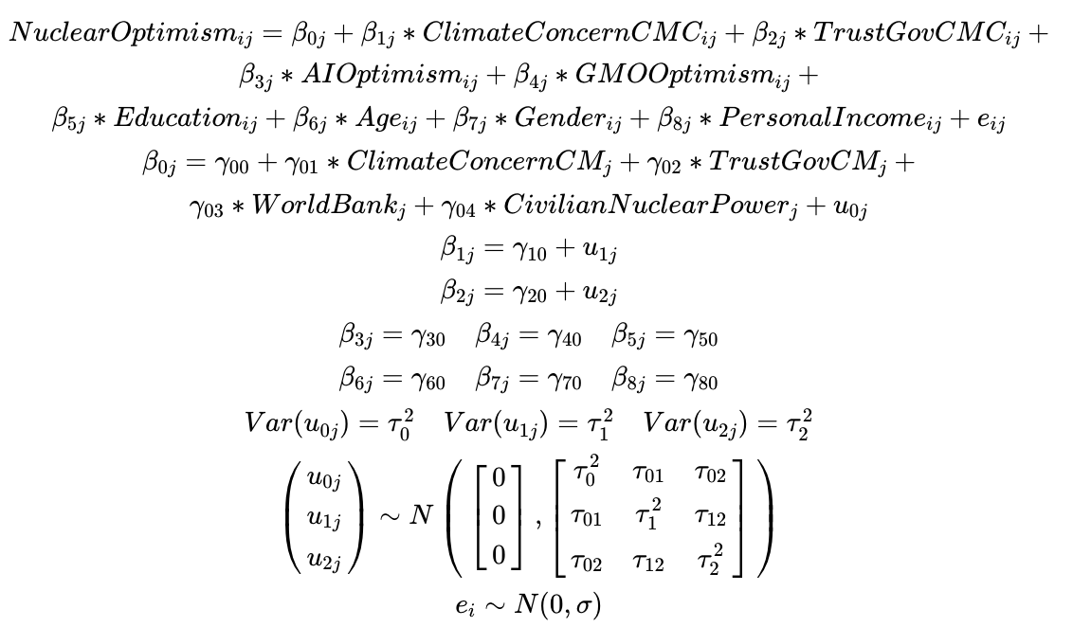
Final model equation

Slide 33
Works cited
OECD, 2010: https://www.oecd-nea.org/jcms/pl_14534
Gallup, 2019: https://news.gallup.com/poll/248048/years-three-mile-island-americans-split-nuclear-power.aspx
Pampel, 2011: https://journals.sagepub.com/doi/abs/10.1177/1086026611422261
Katsuya, 2002: https://onlinelibrary.wiley.com/doi/abs/10.1111/0162-895X.00277
Kim & Kim, 2021: https://www.mdpi.com/1996-1073/14/18/5774/pdf

Slide 34
Link to code
GitHub: https://github.com/JoshuaInwald/575FinalProject
File guide:
Data file: lrf_public_file_review.tab
Dataset codebook: LRF Codebook.pdf
Final R analysis script: script.R
Markdown file version of final analysis script: markdown.RMD
Backup of presentation (this file): powerpoint.ppt

